Slide 1


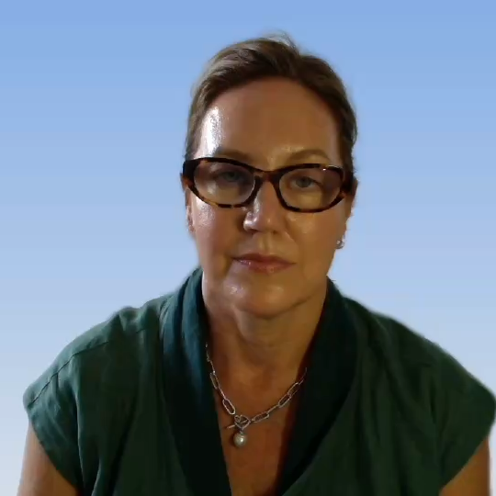





AUSNZ Women’s Empowerment in Leadership
2026 Bookclub series
Drs Tanya Farrell, Maryann Turner, Lia Freestone
and Alison Brereton as well as A/Prof Suzi Nou
11th February 2026
Online
Notes:
Hi there, My name is Tanya Farrell and I am one of the founders of the Australian and NZ Chapter of WELI. This chapter has been established with the help of the North American WELI who were established a few years back by the Society of Paediatric Anaesthesiology. if you are watching this video, you will have been invited as either an advisor or a protege as part of our 2026 Bookclub series. The first one is on February 11, in the evening depending where you are, and you will receive an invitation along with resources to prepare for the session.

Slide 2

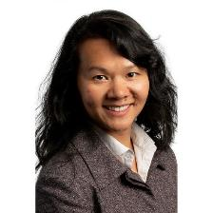
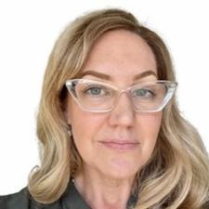
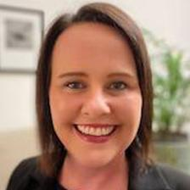



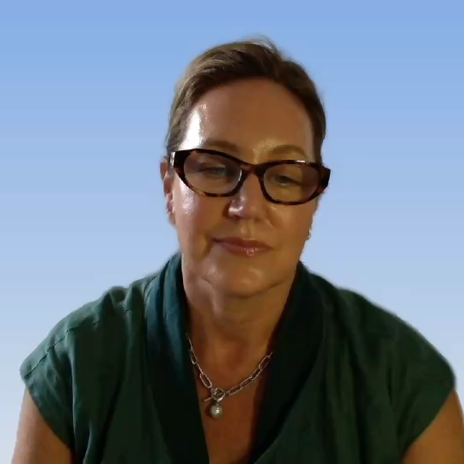
Acknowledgements
A/Prof Suzi Nou
Dr Tanya Farrell
Dr Maryann Turner
Immediate Past President,
ASA
President, SPANZA
Previous Councillor, ANZCA
Notes:
Drs Maryann Turner, and Assoc Prof Suzi Nou, helped establish the AUSNZ chapter with the help of WELI. We have the backing of ANZCA, the ASA and SPANZA, and some of you may have attended a workshop or breakfast sponsored by AUSNZ WELI at one of the ASMs.

Slide 3
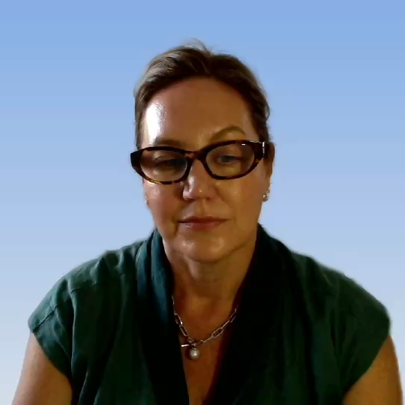
Curriculum subcommittee
Dr Lia Freestone
Dr Alison Brereton
Notes:
These sessions have been orchestrated by our curriculum subcommittee, Drs Lia Freestone, and Alison Brereton, who have been with us from the beginning of the AUSNZWELI journey. We’ve all been working together to develop a program that will be accessible to as many of the protégé and advisors as possible, not be too onerous in terms of preparation, and hit the key messages along with a chance to expand networks and grow connections. It’s been an iterative process so far, and we’re keen to keep evolving according the needs of our members.

Slide 4

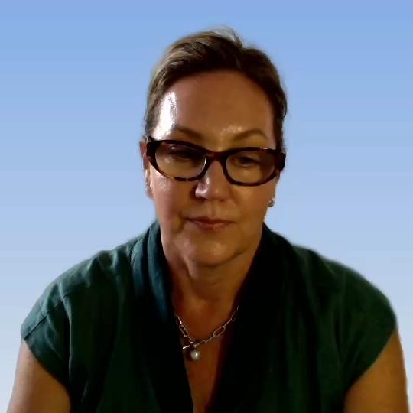
Introducing the Book Club series
Notes:
And so that’s how we have landed on a bookclub series as the primary vehicle for the program this year. The first of which will take place on Feb 11 in an online format. These sessions will only be available to the dyads, that is, the protégé and advisors members of WELI. We are hoping these sessions provide a great platform for discussion and evolution of ideas based on leadership topic, and a chance to meet other anaesthetists who are looking to develop and refine their leadership skills. The sessions are designed to be interactive and centred around a topic of interest which will form the basis of discussion at our online meeting. Ahead of each session, we will provide some brief background and resources, in the form of a short video like this one, introducing some ideas on the topic, and some questions to initiate discussions at the online session.

Slide 5
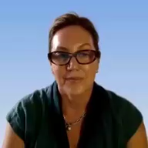
First Bookclub
1
2
3
Introducing BookClub sessions
Developing a code of conduct
Managers and Leaders
Background and context
By you as members, for you
Introducing the topic and the resources
Notes:
When we meet on Feb 11, we’ll provide a bit more context around the series along with some of the topics we hope to discuss further into the year, we’ll also spend a few minutes to develop a bit of a credo or some rules of engagement for the sessions, and so we’re hoping you guys will have some ideas about what you want from the sessions and how you want them to run. And then we’ll move onto the first topic for some discussion – that is, exploring the differences between management and leadership, understanding the skills and a little bit more about your own tendencies, and what might need some more development or attention.
At the beginning of each online session, we will spend a few moments introducing ourselves to each other, and before we meet online for the first time, I’d like to recommend a structured approach for introducing yourself developed by WELI friend and collaborator, Dr Andrea Wojnicki. Andrea is a communications expert based in Toronto who will be providing some of the content for our program this year. She has a brief podcast on this very topic, and I’ll attach a link to that in the notes that accompany this video, but its super simple, easy to remember, and very effective for allowing you to let go of some the stress that we sometimes find when we are asked to introduce ourselves, and we find ourselves madly trying to find something appropriate, professional sounding and witty and forget to listen to the others in the room as they introduce themselves. To summarise it here;

Slide 6
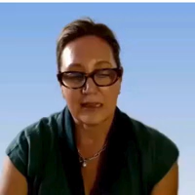
Introducing Yourself
1
2
3
Your Name
Past
Future
Hi, I am Tanya Farrell
I am an Anaesthetist in Perth, the President of SPANZA and a co-founder of AUSNZ WELI
I’m really excited to meet with female and non binary leaders within anaesthesia and share skills and knowledge in an effort to address some of the current inequities.
Notes:
there are 3 elements, and they are deliberately easy to remember. the first is your name, followed by a brief statement centered on your past, role or experience, depending upon what the context is, and then something with regard to future goals or aspirations, or even just something forward facing. So for me that might sound something like;
Having a structure that is easy to remember makes it much easier for you to put a professional sounding introduction out into a room of people you might admire, or feel a little intimidated by, and clear some the mental space you would be otherwise take up with compiling something witty and clever so that you can listen, hear and take in what other people are saying during their own introductions.

Slide 7
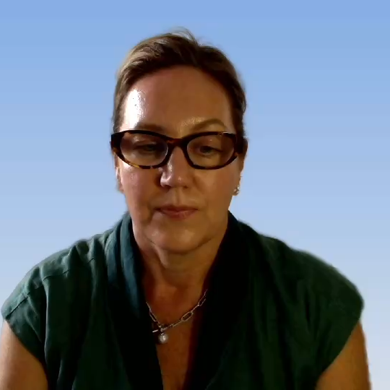
Developing our Credo
Notes:
As I mentioned before, we will spend some time developing a credo for our sessions to ensure you are maximising the time your investing and everyone is clear on what we expect of each other. Some of the things you might think about ahead of our first session are

Slide 8
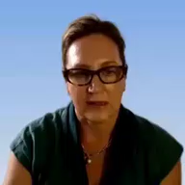
Consider;
1
Respect, inclusivity, communication
4
Confidentiality
2
Engagement, punctuality and preparedness
5
Use of technology, camera, chat, mikes
3
Conflict resolution
6
Learning, growth and feedback
Notes:
how to ensure that we encourage diverse opinions and active sharing of insights
Rules for communication, with particular emphasis on clarity and active listening
How we can maximise Engagement – e.g. would you like to see breakout rooms for small group discussion and interactive polls in our sessions together
Roles and responsibility for contributing to a positive environment
how do we address conflict if it arises?
how would you like to see confidentiality handled?
What should we expect of each other with regard to punctuality and preparedness, given we’re all pretty busy and have multiple balls in the air.
How would you like to Use technology such as cameras, chat functions, and microphones
how should we encourage collective learning and personal development throughout the series?
how would you like to channel feedback for the purpose of continuous improvement?

Slide 9
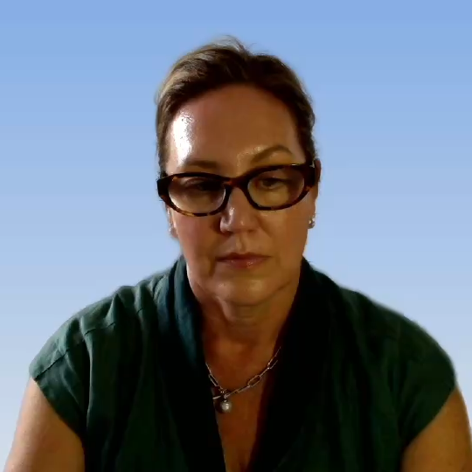
Managers do things right, Leaders do the right things.
Warren Bennis
Notes:
The second part of the session will be exploring the differences between management and leadership. Many of you will have some experience in these areas and will have some great ideas, so I’m looking forward to sharing those with you .
There is a bit of a tendency to use the terms management and leadership interchangeably but it is well accepted in the current business and healthcare literature that there are key differences; although some would consider them a continuum or 2 sides to a coin, like Warren Beavis, a leadership expert, quoted here.
.

Slide 10
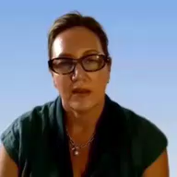
Zaleznik; Managers and Leaders are different people
Managers
Leaders
Suppress emotions for rational decision making
Create change and innovation
Order and efficiency; processes, structure and control
Visionaries who inspire and motivate
Embrace conflict
Ensure stability
Work with established boundaries, data and control mechanisms
Engage with emotions to connect and foster engagement
Thrive in ambiguity and take risks
Avoid conflict
Notes:
The idea or concept was probably first articulated in detail by Abraham Zaleznik in the 70’s in an article published in the Harvard Business Review.
At that time, bigger corporations were quite focused on management aspects of doing business, and Zaleznik contended that in order to succeed sustainably over time in increasingly complex environments, companies needed to develop leadership capability alongside effective management, that is develop vision, take risks, drive transformation and embrace ambiguity.
Zaleznik contends that due to the fundamental differences in these two approaches, it is difficult to be both a manager and a leader.
Because managers focus on maintaining order and efficiency, emphasising processes, structure and control, relying on established methods and systems, while leaders tend to be more visionary who inspire and motivate people. They focus on creating change and driving innovation
Where managers tend to suppress emotions in favour of rational decision-making, leaders engage with emotions, using them to connect with team members and foster engagement.
Managers typically avoid conflict, seeking to maintain stability, whereas leaders embrace conflict as a necessary part of growth and change, viewing it as an opportunity for development.
Managers usually work within established boundaries and prefer to make decisions based on data and control mechanisms. Leaders, on the other hand, thrive in ambiguity and are comfortable taking risks to pursue their vision.
Zaleznik argues that organizations need leaders to drive transformation and adapt to changing environments, as well as managers to ensure stability and that effective organizations require a balance of both managerial and leadership styles to navigate the complexities of their environments, but contended that these styles would reside in different people – for example, the CEO or top tier personnel would be more likely to be leaders, whereas, managers would be better suited at the execution end of the organisation. So, in the way that Zaleznik introduced the two paradigms it would have been unusual to see the leadership styles as he described in many places other than at the very tip of the organisation – in the CEO or close by in the c Suite.
But we know in complex healthcare environments, that leadership is required at all levels and that many clinicians, while needing to be good managers in order to cope from a day to day basis, will often have many leadership qualities as well as the experience and corporate knowledge to be able to exert these in healthcare organisations.
In addition, there is this concept of ‘what got you here, won’t get you there…..’ (which is actually a book written by a leadership coach named Marshall Goldsmith, about understanding the habits and behaviours that might be holding you back on your leadership journey) but also refers to the group of skills and behaviours that have got you into management positions, will not necessarily serve you when a role calls for more vision or involves a greater level of risk and ambiguity. It might be good to spend some time understanding what your natural tendencies are and developing those aspects that don’t come easily to you.

Slide 11
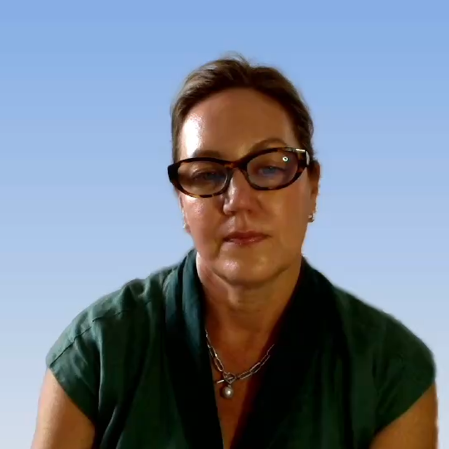
Notes:
Since then there has been much discussion about how the two inter-relate and this discourse is nicely summarised by Swanick who wrote a short succinct summary in the learning zone for BMJ leader in 2016, and which I’ll attach to the notes for this session. He has included this table adapted from some work by Northouse who talks about a balance whereby with good management skills one can produce order and consistency and developing or understanding aspects of leadership can help drive change, adaptation and innovation.

Slide 12

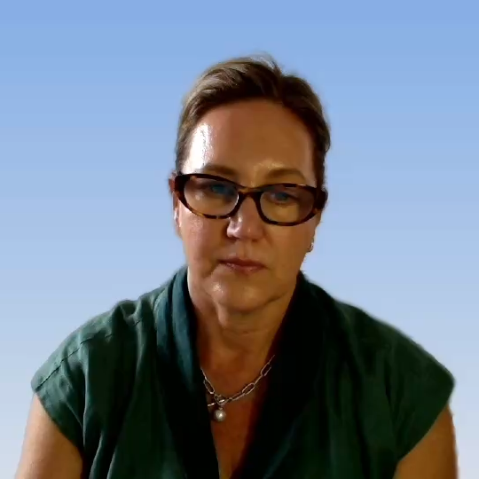
Management | Leadership
Managing processes or stable tasks, e.g. writing the rota | Managing people through changes, e.g. providing a safe service with reduced resources and increased demand
Short-term focus | Long-term focus
Target setting | Vision setting
‘Tame’ problems (problems with solutions readily apparent) | ‘Wicked’ problems (problems that have complex solutions or perhaps no solution at all)
Doing things right | Doing the right thing
Notes:
We know that in reality the tasks of both the manager and the leader usually fall to the same people; both are important; organisations which are over managed but under led eventually lost any sense of spirit or purpose, while poorly managed organisations with strong charismatic leaders may soar temporarily only to crash shortly thereafter. The challenge requires the objective perspective of the manager as well as the brilliant flashes of vision and commitment wise leadership provides.

Slide 13
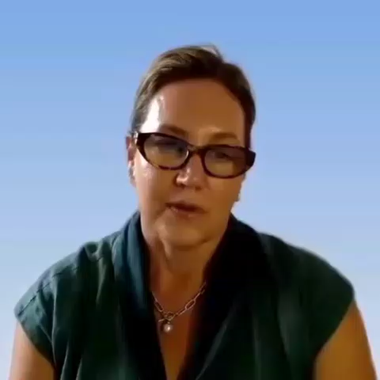
Medical leadership in perioperative practice: I, C Johnson et al BJA education 2016
Notes:
Fig 2 The Medical Leadership Competency Framework—©NHS Leadership
Academy and Academy of Medical Royal Colleges, 2010. All rights reserved.
This is an example of what is required of clinicians in leadership roles within complex healthcare organisations. Its based on an NHS model which to be fair to them despite their problems have probably led the way in terms of documenting and developing frameworks for clinical leadership. As you can see, there are several qualities and skills required in order to achieve the defined objective, in this case, delivering the healthcare service. So now, in 2026, we really need to empower clinicians in leadership with knowledge and skills and insights that bring out both managerial aspects as well as leverage and develop leadership qualities.
So, I’ve very briefly introduced some ideas around the characteristics of managers and leaders, and talked about them as either inherent personality traits, or potentially skillsets that can be developed and exercised before touching on where we might find each within an organisation. I’d like you to take a brief moment to consider your own experiences. To prompt some of the thoughts on these ideas, I’m going to include a few questions along with the resources for you to consider and reflect upon, touching on the themes of management and leadership and we might use these to kick off some of the discussion when we meet.

Slide 14

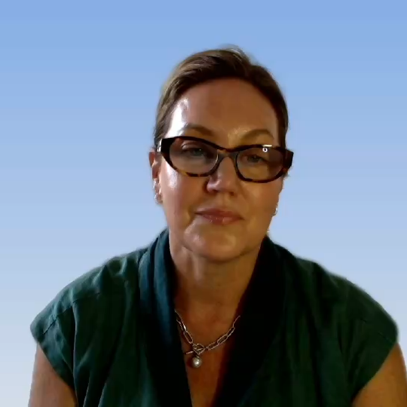
Notes:
Until then, please have a look at the resources, podcast link and worksheet with the questions – let us know if you have any problems and I’ll look forward to seeing you all on Feb 11!

