Slide 1






Herrmann
Whole Brain Thinking
Model
Assoc Prof Suzi Nou
Notes:
Understanding the Herrmann Model is valuable for anyone progressing their leadership journey because effective leadership is not just about what you know – it’s about how you think, communicate, and influence others. The model builds self-awareness, strengthens communication, and supports more balanced, confident leadership.

Slide 2


With kind permission from Oral Roberts
Notes:
I’d like to take this opportunity to acknowledge Māori as tangata whenua and Treaty of Waitangi partners in Aotearoa New Zealand.
I would also like to acknwoledge the Traditional Custodians of Country throughout Australia and recognize their cultural and spiritual relationships to the land, waters and seas and rich contribution to society.
We pay our respects to ancestors and Elders, past and present.
This is painting by Oral Roberts that was commissioned and gifted to the ASA by Past President David Scott and gifted to the ASA. It is a representation of Australian anaesthesia as well as Oral's close connection with the Bundjalung land and culture.
https://paperrepublic.com.au/product/blueislandpressmedium2022wallcalendar11/
https://planetcorroboree.com.au/products/greeting-card-koala-by-oral-Roberts
NZ/Maori image and words needed. Should Maori acknowledgement go first in NZ?

Slide 3
Disclaimers
1
2
3
This is based on the work of Ned Herrmann
I am not HBDI certified
References at the end
Herrmann Brain Dominance Instrument
WELI: Herrmann Whole Brain Thinking Model
Notes:
Ned Herrmann was the manager of Management Education for General Electric in the 1970s.

Slide 4
AUS NZ WELI Credo
We have a shared purpose to empower, uplift and support women to become better leaders
1
2
3
We lead by example with professionalism, integrity and maintaining each other's confidentiality.
We communicate respectfully, are open to expressing our views and we see conflict as an opportunity for growth.
We respect the time and commitment that others have put into this group.
We recognise that everybody wants to be here, and we accept with flexibility that others may have competing interests.
We aim to attend at least 75% of these sessions and be present with our cameras on.
We accept that recordings of our sessions will not be made available afterwards.
AUSNZ WELI: Herrmann Whole Brain Thinking Model
Notes:
Ned Herrmann was the manager of Management Education for General Electric in the 1970s.

Slide 5
Book Club Session Overview
Know Yourself
To Work with Others
To Empower Teams
To Support Leaders
Reflection
Communication
Collaboration
Coaching
Leadership vs Management
Leadership Styles
Values (true North)
Thinking Models
Past Experiences (crucible moments)
Influence & Persuasion
Negotiation
Conflict Resolution
Managing Up
Governance
Risk
Financial Management
Strategic Thinking
Change Management
Coaching
Networking
Board of Directors
AUSNZ WELI: Herrmann Whole Brain Thinking Model
Notes:
Need to update images

Slide 6
1
Theory Developed in the 1970s
Developed by Ned Herrmann
2
Herrmann Brain Dominance Instrument
Background
116 question, validated survey
3
Whole Brain Thinking Model
4 quadrants
AUSNZ WELI: Herrmann Whole Brain Thinking Model
Notes:
Similar concepts such as
Myers-Briggs Type Indicator
Process Communication Model
Why I like this one
Intuitive, simple

Slide 7
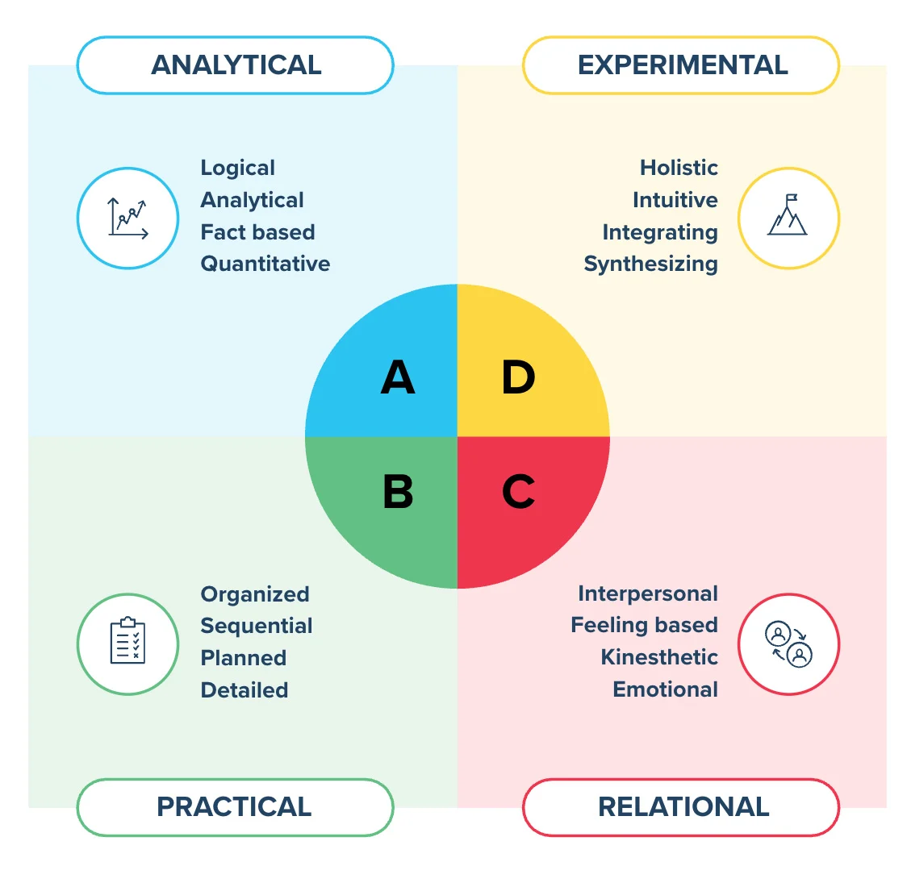
The Model
Notes:
Of course, like all of these frameworks, most people don’t sit entirely within one quadrant but can display a range of characteristics.

Slide 8
Analysis
Quantifies
Is logical
Is critical
Is realistic
Likes numbers
Knows about money
Knows how things work
Infers
Imagines
Speculates
Takes risks
Is impetuous
Breaks rules
Likes surprises
Is curious and playful
Takes preventive action
Establishes procedure
Gets things done
Is reliable
Organises
Is timely
Is neat
Plans
Is sensitive to others
Likes to teach
Touches a lot
Is supportive
Is expressive
Is emotional
Talks a lot
feels

Slide 9
ANALYTICAL
Business like
Appropriate fixtures or artwork
Look of efficiency, consistent with industry
Sparse, clean desktop
Orderly office
Business like, formal or appropriate
Little head or body movement
Down to business attitude
EXPERIMENTAL
Lots of colour,
Original art & decorative features
Aesthetically pleasing colour
Cluttered
Paper piles and toys
Independent, sporty
Could look distracted
Sketches and doodles
Office
Work space
Attire
Body language
PRACTICAL
Traditional look and feel
No impractical or unnecessary items
Neat and orderly, organised
Sparse, clean desktop
Orderly office
Traditional, neat, conservative or classic
No extreme facial expressions
Arms side or folded
RELATIONAL
Friendly, comfortable
Photos of employees, people
Very inviting
Filled with personal memorabilia
Comfortable, loose, informal
Nods head a lot to acknowledge
Lots of eye contact
Notes:
Green: I need 15 mins of your time to talk about XYZ
Red: I really would love it if we could spend 5 mins talking about…
Blue: can handle the lengthy emails
Yellow: no lengthy emails please!

Slide 10

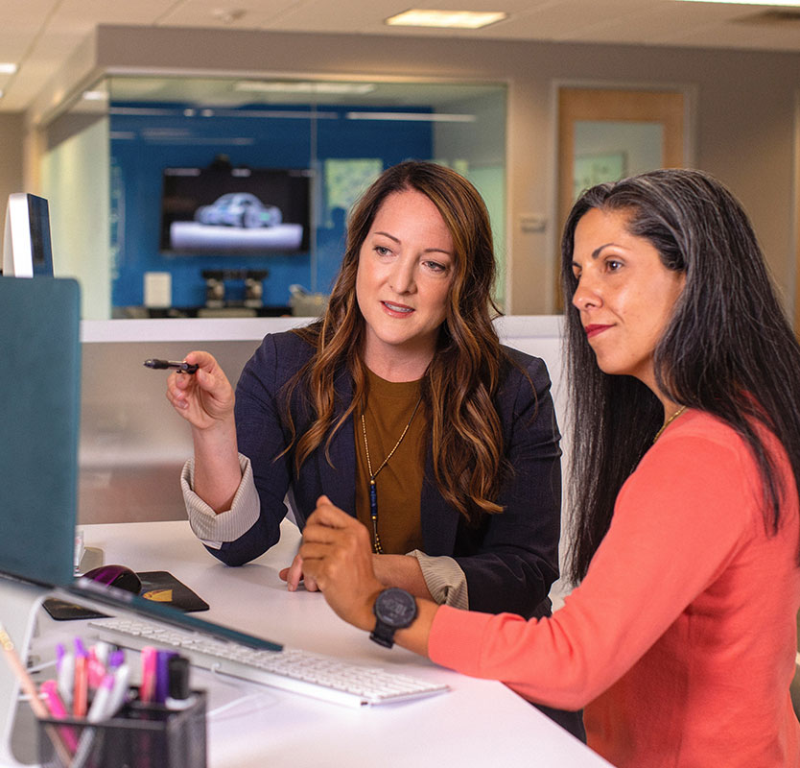



Reflection & Discussion
With which quadrant do you most identify?
Resources
Analytical (blue)
Practical (green)
Relational (red)
Experimental (yellow)
Look at the resources and come prepared to our discussion
Can you identify the quadrants of others?
Who would you want on your team?
Thinking of your leadership goal, who would you like to have on your team?
Work colleagues
AUSNZ WELI: Herrmann Whole Brain Thinking Model

Slide 11
Reflection:
With which quadrant do you most identify?
AUSNZ WELI: Herrmann Whole Brain Thinking Model
Notes:
I will follow up with a second part to this talk, but before I do, I wanted you to do some reflection. We’ll meet and discuss this

Slide 12
Reflection
Thinking of your leadership goal(s) who would you like to have on your team?
AUSNZ WELI: Herrmann Whole Brain Thinking Model
Notes:
Could you identify the quadrants of others?

Slide 13
1
Self-awareness
2
Collaboration and Communication
Uses
3
Organisational
Cultural
WELI: Herrmann Whole Brain Thinking Model – Part 1
Notes:
Why I like this one
Intuitive, simple
Has some practical implications in the real world: giving presentations, creating effective teams, delivering projects

Slide 14
Extension:
Someone is contacting you about a project
How would you like to receive that request?
AUSNZ WELI: Herrmann Whole Brain Thinking Model
Notes:
I will follow up with a second part to this talk, but before I do, I wanted you to do some reflection. We’ll meet and discuss this

Slide 15
ANALYTICAL
  Business like
  Formal
  Little head or body movement
  Down to business attitude
  “the bottom line”
  “critical analysis”
  “break it down”
EXPERIMENTAL
Colourful
Cluttered
Independent, sporty
Could look distracted
Sketches and doodles
“the big picture”
“play with an idea”
“concept”
The Model
communication
Body Language
Typical phrases
PRACTICAL
  Traditional, neat,
  Conservative or classic
  No extreme facial expressions
  Arms side or folded
  “sequence”
  “play it safe”
  “by the book”
RELATIONAL
Friendly, comfortable
Informal
Nods head a lot to acknowledge
Lots of eye contact
“team work”
“the family”
“interactive”
Notes:
Green: I need 15 mins of your time to talk about XYZ
Red: I really would love it if we could spend 5 mins talking about…
Blue: can handle the lengthy emails
Yellow: no lengthy emails please!

Slide 16
Summary
1
2
3
Herrmann Brain Whole Thinking Model
Self-Awareness
Collaboration & Communication
4 quadrants:
Analytical (blue)
Practical (green)
Relational (red)
Experimental (yellow)
My quadrant
Other’s quadrants
Teams
Communication preferences
AUSNZ WELI: Herrmann Whole Brain Thinking Model
Notes:
Ned Herrmann was the manager of Management Education for General Electric in the 1970s.

Slide 17
Future Dates
https://ausnzweli.org/members-only/
Tuesday 21st April
Friday 1st May
Wednesday 24th June
Saturday 10th October
Book Club #3
Workshops
Book Club #4
Networking Breakfast
Online
Intentional networking events
ANZCA ASM
Auckland
Liz Crowe
Online
ASA & NZSA CSC
Hunter Valley
AUSNZ WELI: Herrmann Whole Brain Thinking Model
Notes:
Need to update images

Slide 18
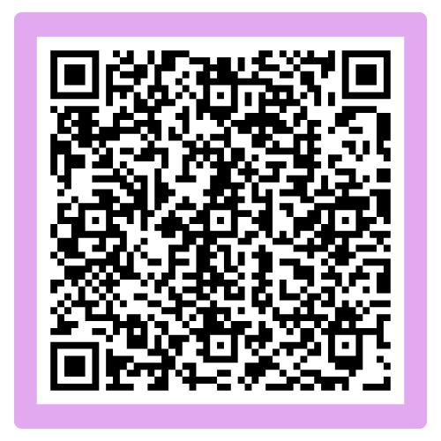
1
Theory Developed in the 1970s
Developed by Ned Herrmann
2
Herrmann Brain Dominance Instrument
Feedback
116 question, validated survey
3
Whole Brain Thinking Model
4 quadrants
AUSNZ WELI: Herrmann Whole Brain Thinking Model
Notes:
https://forms.office.com/Pages/ResponsePage.aspx?id=m8MCaE_0Q0O-kucwtNFYV3OaUSePu4FCmWwL78X9imJUM1hLTDFKQkVaMVc3UVVPVEhaUjVMWUI2VS4u

